Slide 1

Big Mountain Resort Ticket Pricing

Slide 2
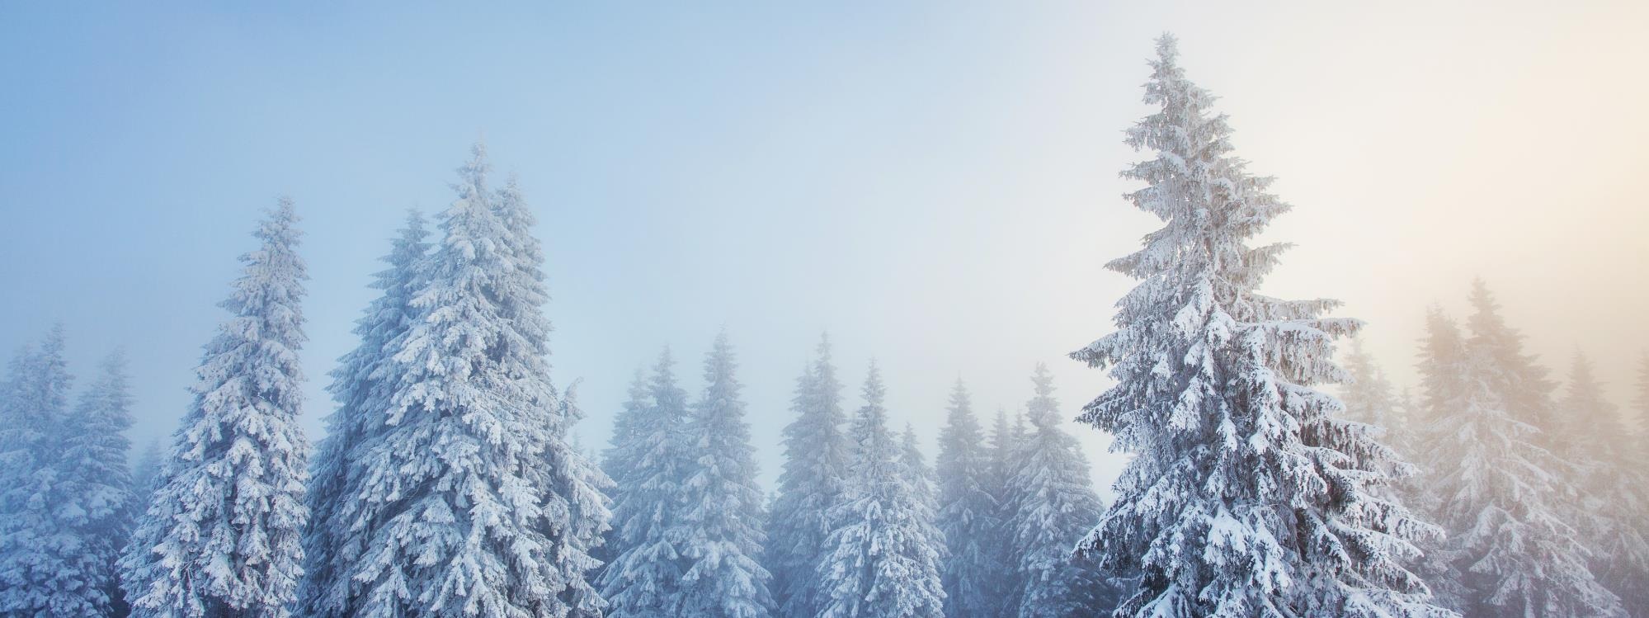
PRIMARY GOAL: Ticket prices that reflect the true value of the Big Mountain Resort experience

Slide 3
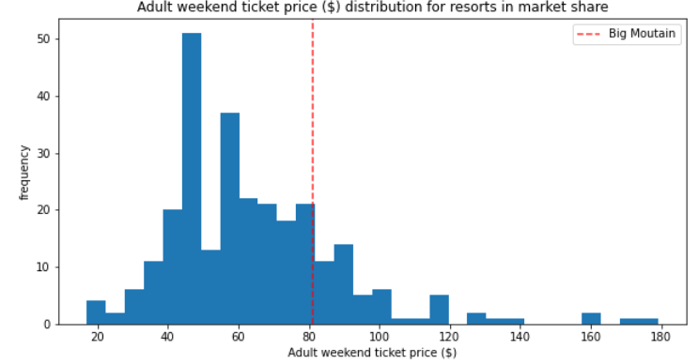
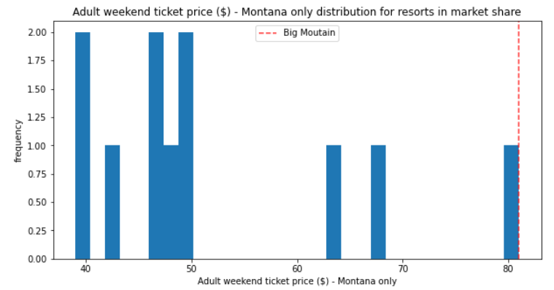
Big Mountain vs. Competition Current Ticket Price
National Market
Montana Market
Notes:
Big Mountain’s ticket price is currently $81 and reflects a price above the industry average. It has the highest price among resorts in Montana.

Slide 4
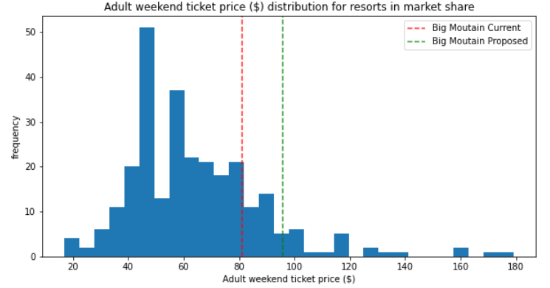
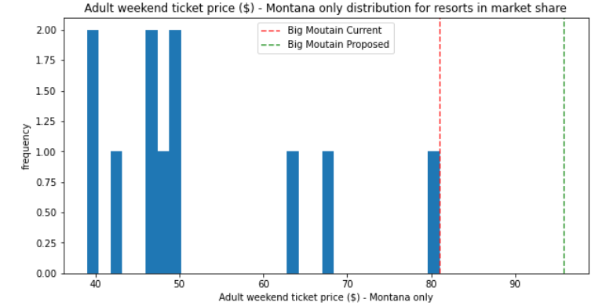
Big Mountain vs. Competition Current vs. Modeled Ticket Price
National Market
Montana Market
$96
$96
Notes:
The model with best fit, which takes the most important resort features into consideration, generates a ticket price of $96 for Big Mountain. This price appears to better align the resort’s ticket price (according to where it ranks on resort features) in comparison to its peers. However, a $15 increase would make the ticket price $29 higher (43% more) than the next highest priced Montana resort.

Slide 5

Impact on Revenue In Millions
 | Total Revenue | Revenue Increase | % Increase | Ticket Price
Current | 141.8 | - | - | $81
Modeled | 167.8 | 26.0 | 18.4% | $96
Modeled, Midpoint | 158.7 | 16.9 | 11.9% | $91
Based on 350k visitors, 5-day visit
Model’s margin of error is approx. $10
Current price is the highest in Montana; new prices create material in-state gap
Recommend a scaled approach
Notes:
Modeled Midpoint = modeled price $96 minus half of margin of error $5.20 ($10.39 divided by 2) = $91 (rounded)

Slide 6
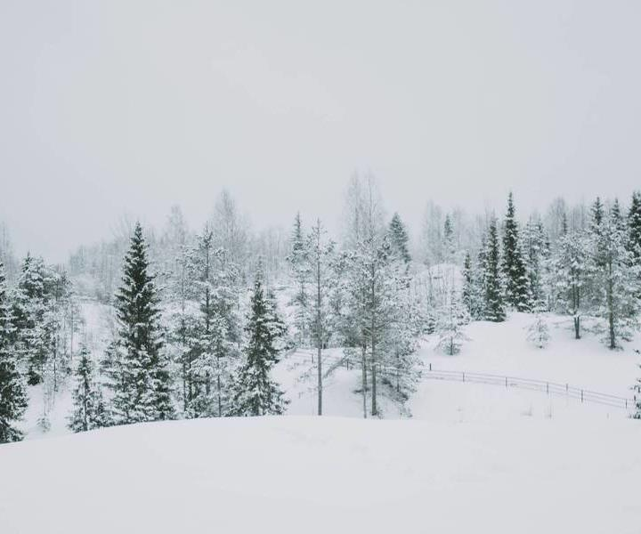
RECOMMENDED STRATEGY: A Scaled Approach
Increase ticket price by $10 for Yr 1, yielding approx. $17M more in revenue
Start tracking in-state, out-of-state visitor totals
Assess market response in terms of visitor count; competitor response
Scale price up in Yr 2 or Yr 3 if visitor response is favorable

Slide 7
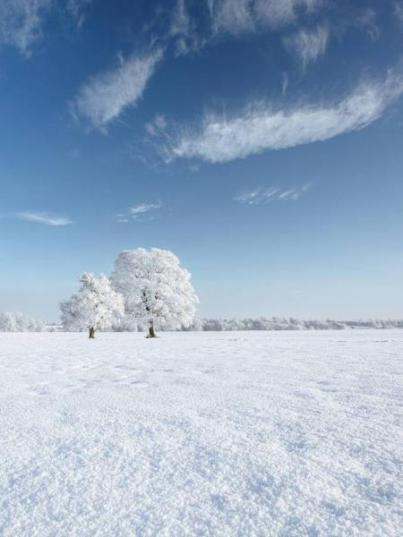
According to the various models used…. WHAT’S IMPORTANT?
Vertical drop
Snow making (acres)
# of chairs
# of fastQuads
# of runs
Longest run
Skiable terrain (acres)
So, how does Big Mountain stack up against its peers…
Notes:
What good is a ski resort without plenty of fresh snow and some great heights to ski down from? Getting skiers to the slopes without long waits makes for happy visitors who come back year after year. Providing plenty of runs, including some long, adventurous ones, and lots of skiable space for skiers to spread out also make for a great experience.
Trams were also identified as important, but resorts don’t have them!

Slide 8
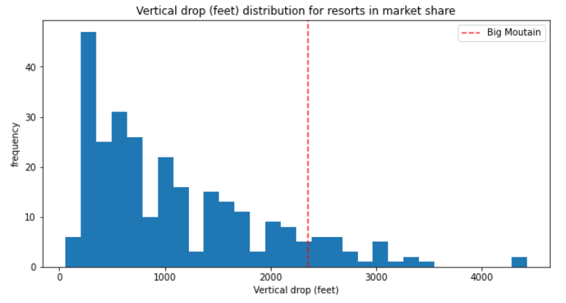
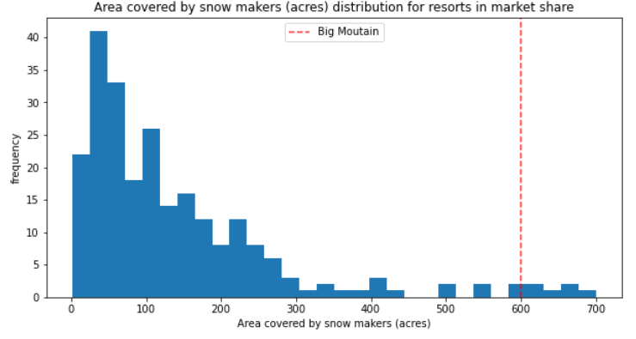
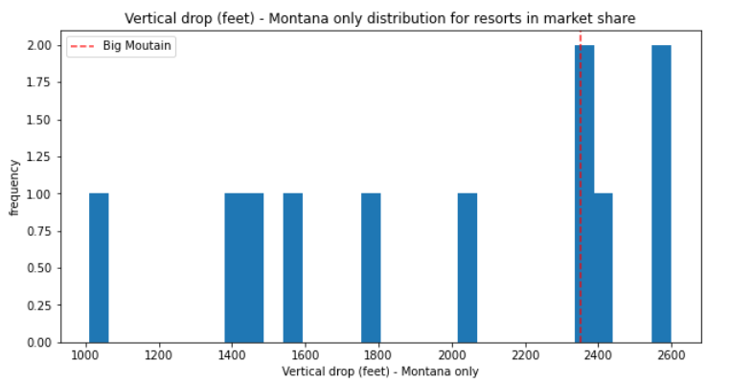
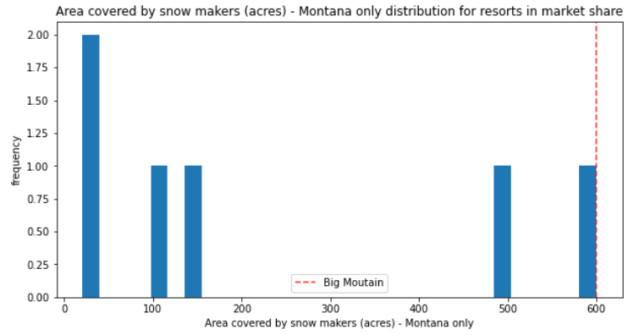
Vertical Drop
Snow Making
Notes:
Each of these comparative slides will compare Big Mountain against all other resorts at the top and Big Mountain as compared to Montana resorts at bottom for each feature specified in the title.
Vertical drop: Big Mountain ranks rather high among its industry peers in vertical drop, but there are other resorts with higher drops.
Snow making: Big Mountain also ranks high among peers in snow making and makes the most snow within the state of Montana.

Slide 9
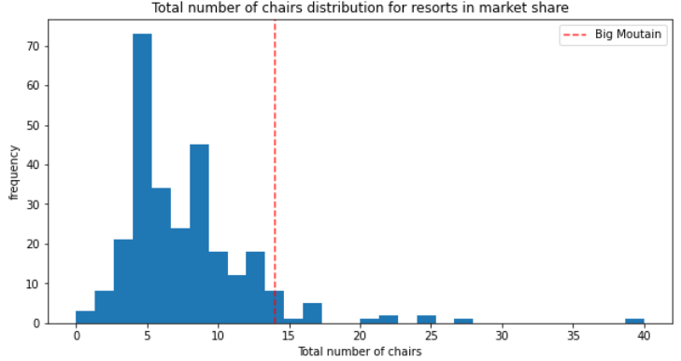
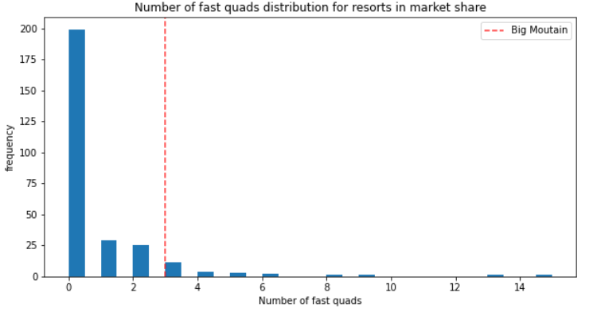
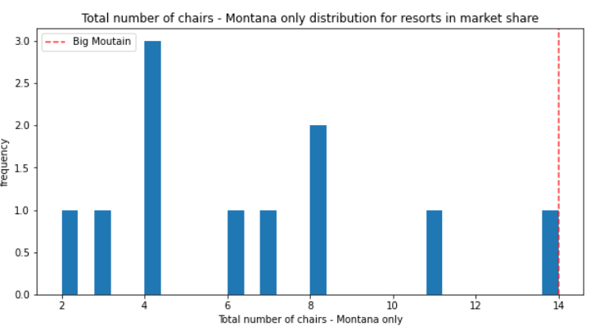
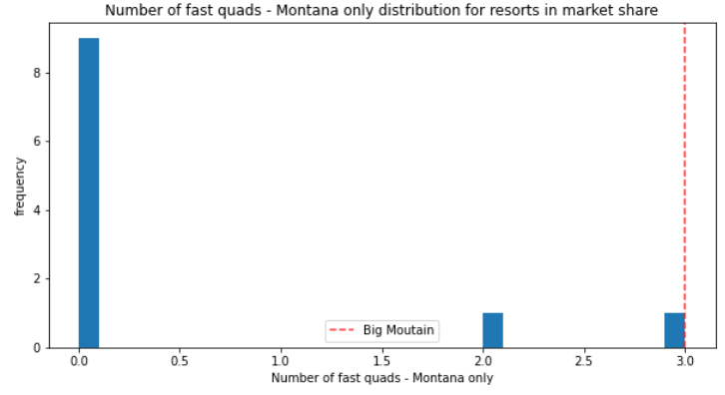
Total Chairs
Total fastQuads
Notes:
Total chairs and total fastQuads: There are a few competitors on the national scene with more chairs and fastQuads than Big Mountain. However, Big Mountain has the most chairs and fastQuads among resorts in Montana.

Slide 10
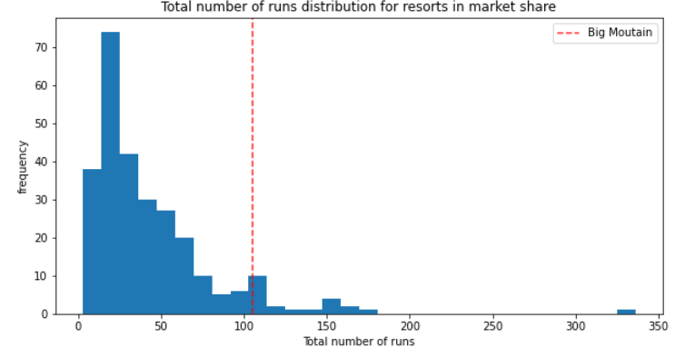
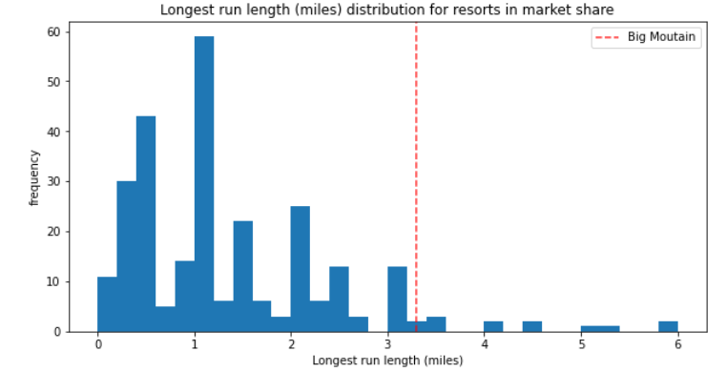
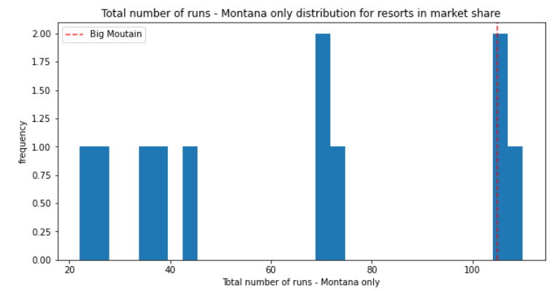
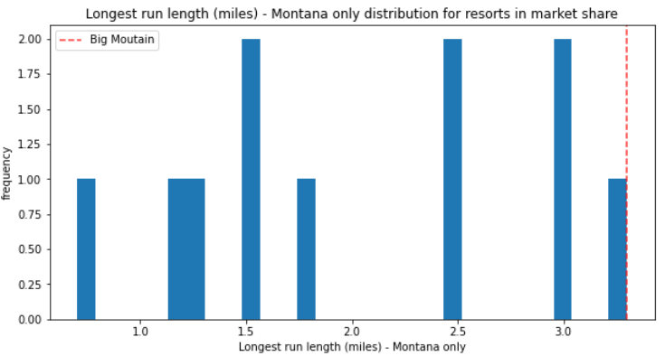
Total Runs
Longest Run
Notes:
Total runs: Big Mountain is among the leaders in both national and in-state comparisons. Looks like one resort in Montana has more runs than Big Mountain while another has the same number of runs.
Longest run: There are a handful of resorts in the country that have longer runs, but Big Mountain has the longest run among the Montana resorts.

Slide 11
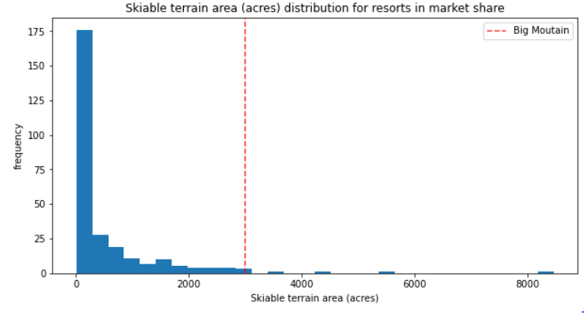
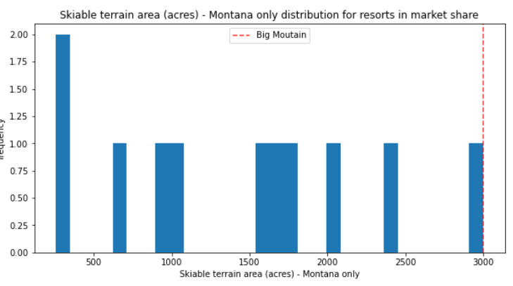
Skiable Terrain
Highlights:
Within Montana, Big Mountain ranks the highest in five of the seven most important resort features
(snow making, total chairs and fastQuads, longest run and skiable terrain)
Nationally, it ranks among the top resorts for all seven features
These findings support the model’s computed price increase of $15, which would raise the ticket price to $96
Since Big Mountain is already the highest priced resort in Montana, increasing the ticket price could price the resort out of the market for in-state visitors
More data is needed on visitors (in-state vs. out-of-state)
Notes:
Skiable terrain: Once again, Big Mountain is on the top for skiable terrain among it’s in-state competitors and nationally, ranks among the top few with the most terrain.

Slide 12
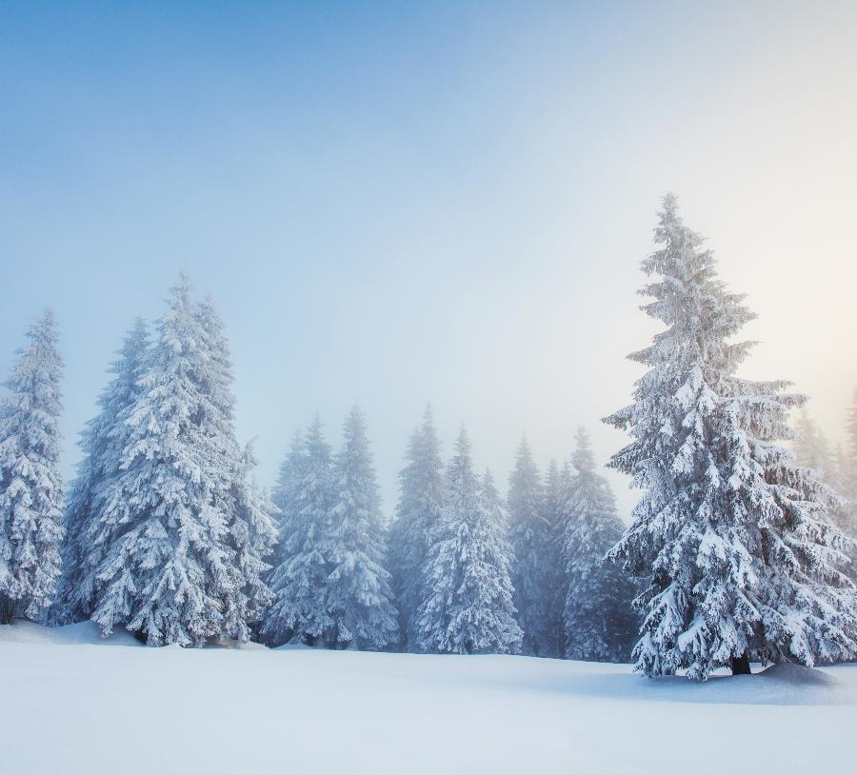
Business opportunities are like buses. There's always another one coming.
RICHARD BRANSON

Slide 13


Scenarios Impact on Revenue, Ticket Price
Option | Revenue Increase/(Decrease) | Change in Tix Price ($)
Closing runs: 1-2* | no material impact | no change
3-5 | $(1.2)M | $(0.67)
6-8 | $(2.2)M | $(1.26)
9-10 | $(3.0) to $(3.2)M | $(1.71) to $(1.81)
Increasing vertical drop, adding run, chair lift | $15.1M | $8.61
Increasing vertical drop, adding run, chair lift + 2 acres of snow making | $17.3M | $9.90
Increasing longest run by 0.2 miles, adding 4 acres of snow making | no change | no change
Based on 350k visitors, 5-day visit
Notes:
In addition to calculating a ticket price based on feature ranking, the model can also adjust ticket price based on changes in features.
Management has been discussing the changes depicted above. The incremental revenue tied to each scenario should be compared to related cost savings/increases, including initial capital outlays.
*Closing 2 runs has some impact, but the ticket price change is less than 50 cents.

Slide 14
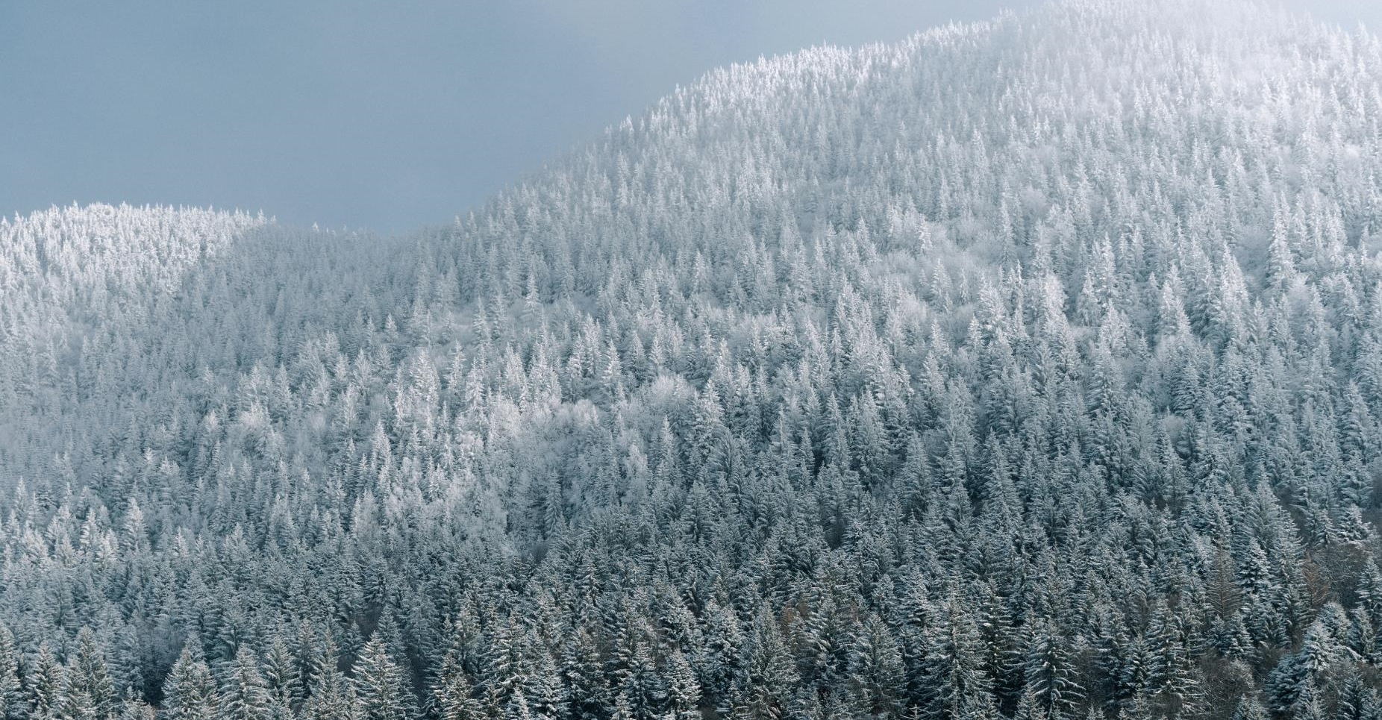
THANK YOU
Sherry Thompson
sherry.thompson@mainline.com
850.509.5939

